Slide 1


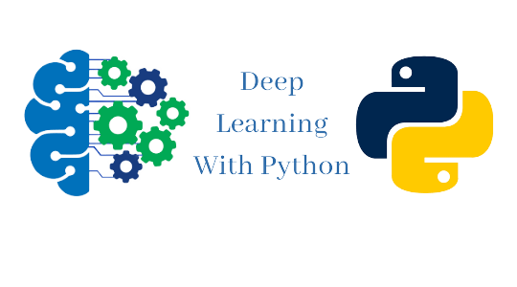


ISCG8050 Machine Learning for Intelligent Data and Information Processing
Week 3 - A
Sources: Hands-On Machine Learning with Scikit-Learn, Keras, and TensorFlow by Aurélien Géron

Slide 2
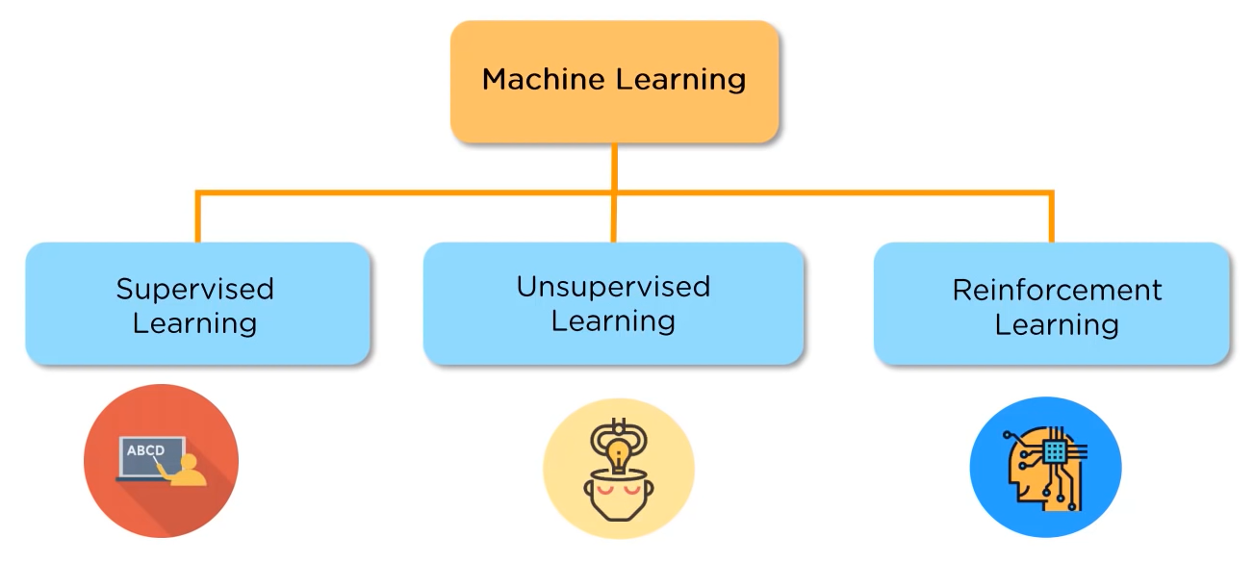
Review
Types of Machine Learning
Supervised Learning
Regression (predicting values)
Classification (predicting classes)
Unsupervised Learning
Reinforcement Learning

Slide 3
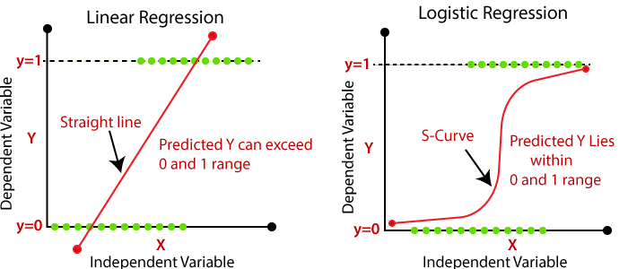
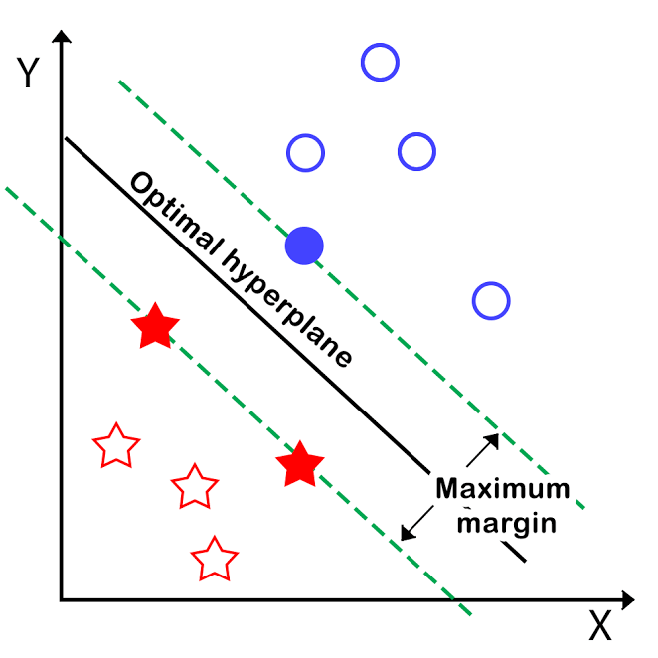
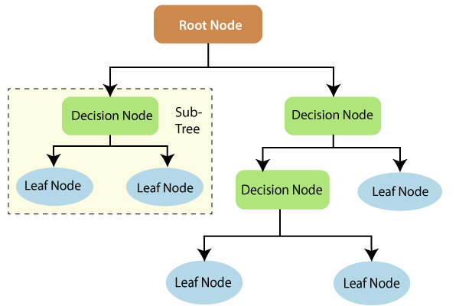
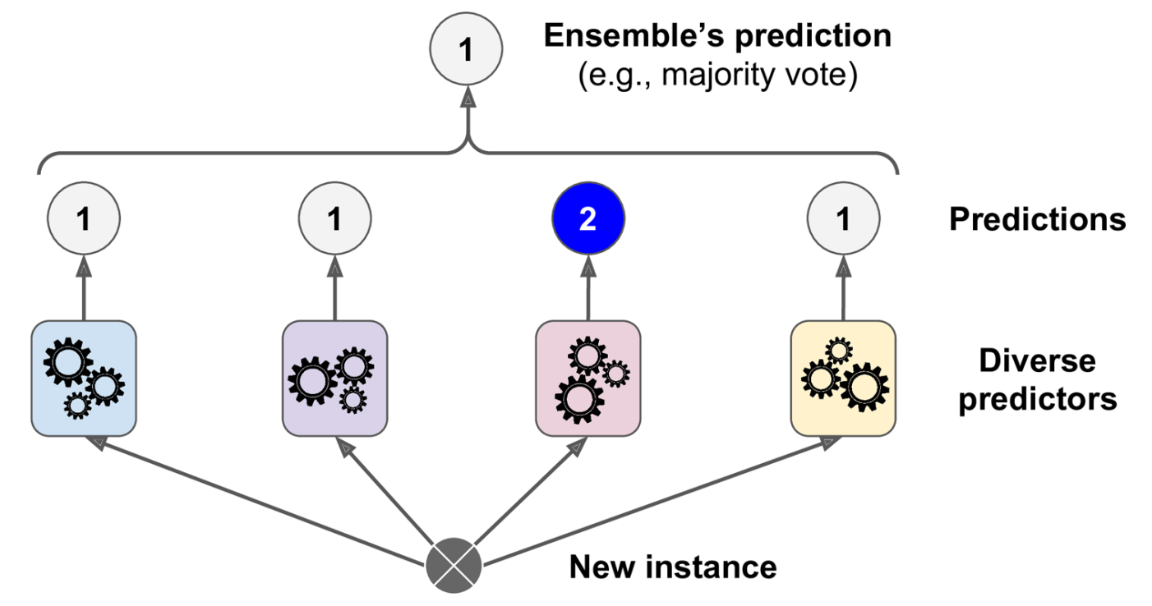
Review
Classification Models :
Logistic Regression
Support Vector Machine
Linear
Non-Linear
Decision Trees
Random Forests
Linear SVM
Splitting
Parent
Child
Child
Decision Trees
Random Forests

Slide 4
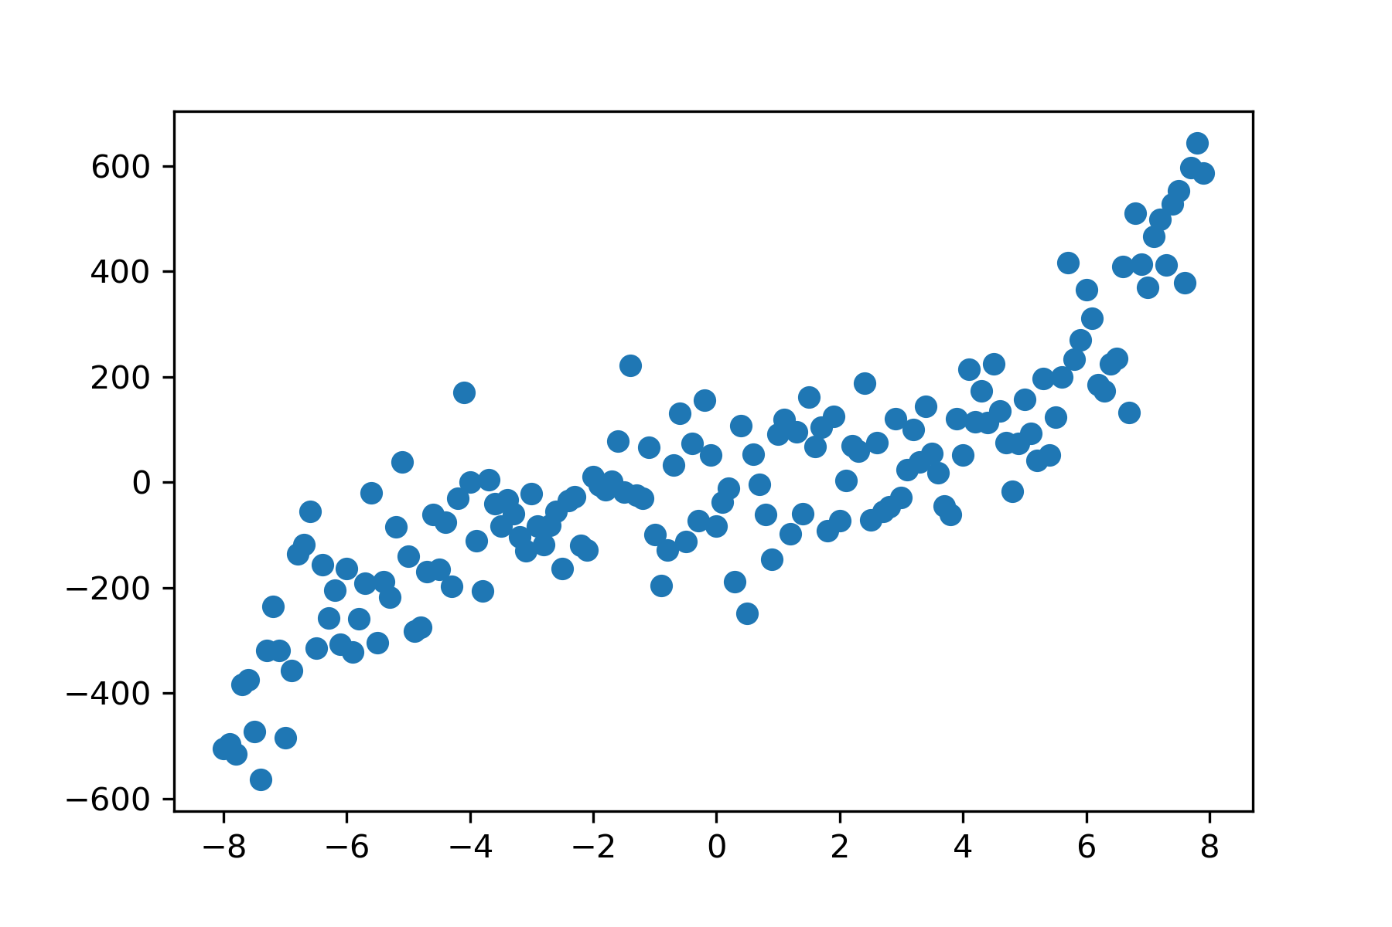
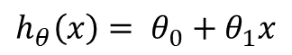
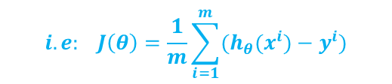
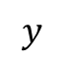
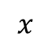
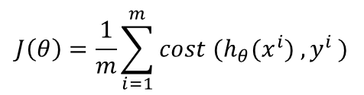
Review
Terminology
Features
Target
Hypothesis
Cost function
Training Set
$$x$$
Learning Algorithm
Some Features
h
Predicted Value
$$y$$
$$h_{θ}\left(x\right)= θ_{0}+θ_{1}x$$
$$J\left(θ\right)=\frac{1}{m}\sum_{i=1}^{m}{{cost (h}_{θ}(x^{i}) {, y}^{i})}$$
$$i.e: J\left(θ\right)=\frac{1}{m}\sum_{i=1}^{m}{{(h}_{θ}(x^{i}) {− y}^{i})}$$

Slide 5

1st Scenario
A security camera company plans to improve their services by adding new software features. (No hardware upgrade)
As a machine learning developer, you know AI can help with the improvements.
What are your recommendations?

Slide 6

2nd Scenario
The same security camera company plans to improve their performance at night. (No hardware upgrade)
What are your recommendations?

Slide 7
Outline
Classification Models:
Neural Networks
Why Neural Networks?
From Biological to Artificial Neurons
Logistic Unit (perceptron)
How Neural Network Works?
Implementing Neural Network with Keras and TensorFlow

Slide 8
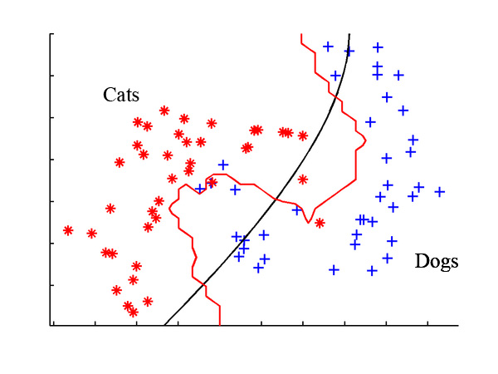
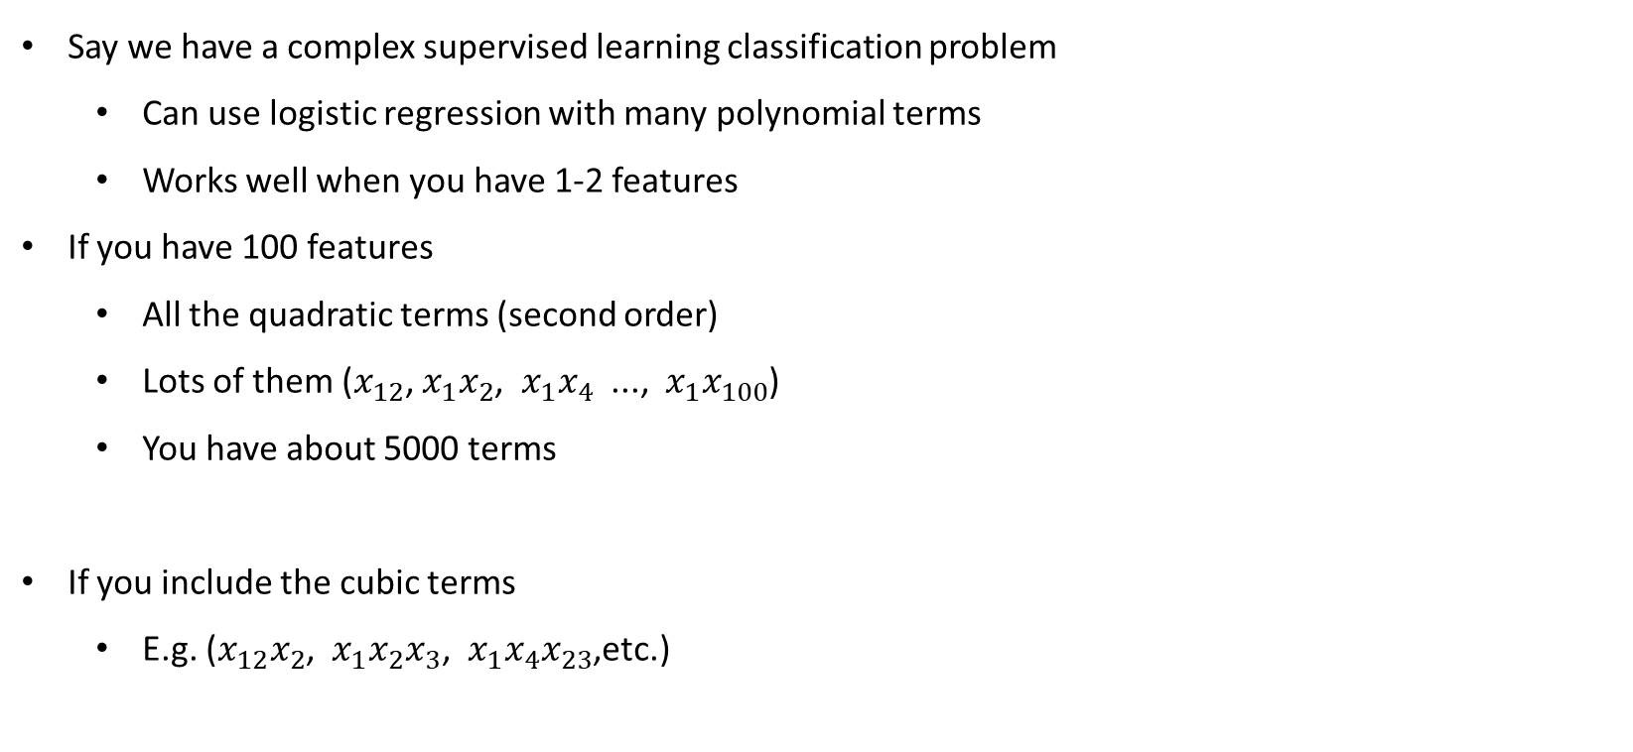
Why Neural Networks?
Say we have a complex supervised learning classification problem
Can use logistic regression with many polynomial terms
Works well when you have 1-2 features
If you have 100 features
All the quadratic terms (second order)
Lots of them ($x_{12}$, $x_{1}x_{2}$, $x_{1}x_{4}$ ..., $x_{1}x_{100}$)
You have about 5000 terms
If you include the cubic terms
E.g. ($x_{12}x_{2}$, $x_{1}x_{2}x_{3}$, $x_{1}x_{4}x_{23}$,etc.)
x1
x2

Slide 9

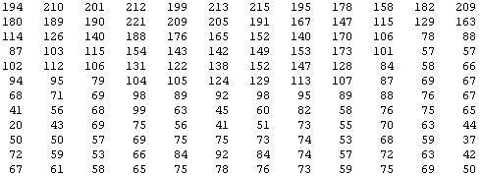
Why Neural Networks?
Problems where n is large: computer vision
Computer vision sees a matrix of pixel intensity values
To build a car detector, build a training set of {Not cars, Cars} then test against a car
You see this:
But the camera sees this:

Slide 10


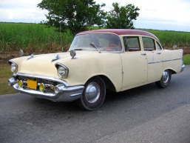






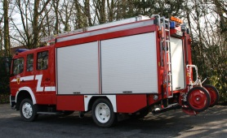

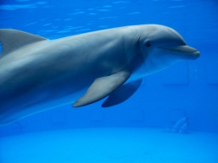

Why Neural Networks? Computer Vision: Car Detection
Car or No Car
Cars
Not a car
Testing:

Slide 11
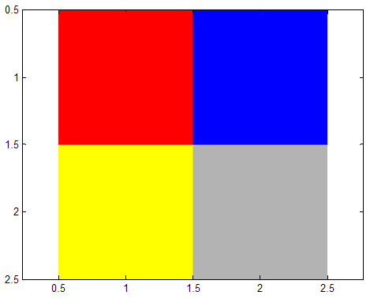




Why Neural Networks? Computer Vision: Car Detection
pixel 1
Plot two pixels (two pixel locations)
Plot car or not car on the graph
Learning Algorithm
2 pixels
pixel 2
Raw image
pixel 2
4 pixels
Cars
pixel 1
“Non”-Cars

Slide 12
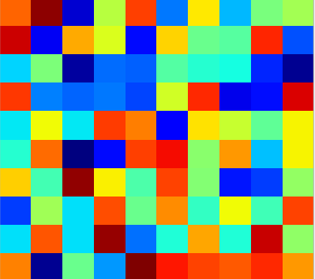
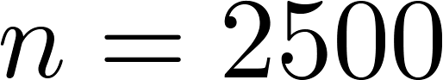
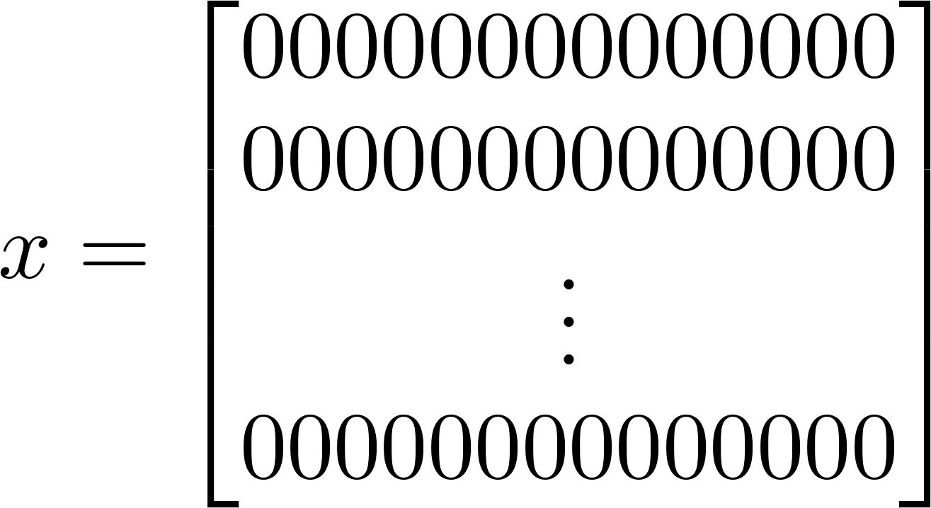

Why Neural Networks? Computer Vision: Car Detection
Need a non-linear hypothesis to separate the classes
pixel 1
Learning Algorithm
pixel 2
Raw image
50 x 50 pixel images→ 2500 pixels
(7500 if RGB)
pixel 2
pixel 1 intensity
pixel 2 intensity
pixel 2500 intensity
Cars
pixel 1
“Non”-Cars
Too big - way too big for logistic regression

Slide 13
Neural Networks Applications
NNs are at the very core of Deep Learning.
They are versatile, powerful, and scalable, making them ideal to tackle large and highly complex Machine Learning tasks such as:
Classifying billions of images (e.g., Google Images),
Powering speech recognition services (e.g., Apple’s Siri),
Recommending the best videos to watch to hundreds of millions of users every day (e.g., YouTube),
Learning to beat the world champion at the game of Go (DeepMind’s AlphaGo).

Slide 14
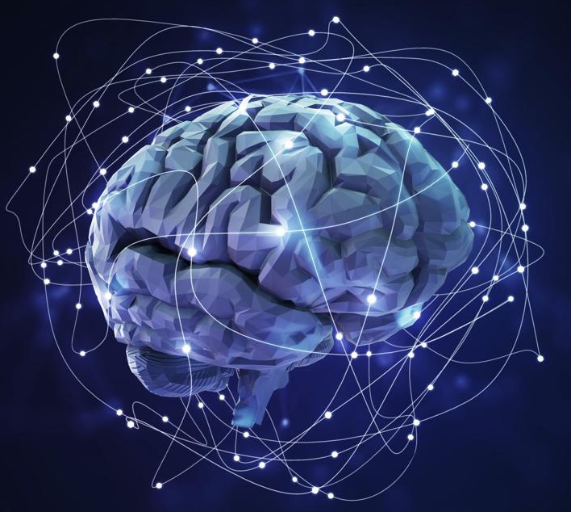
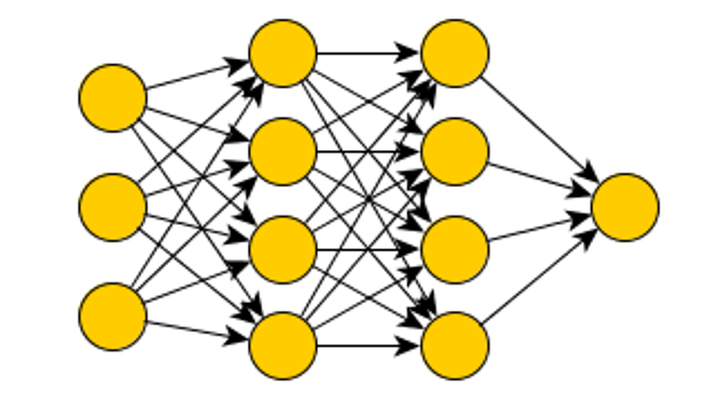
Neural Networks
The brain’s architecture is an inspiration on how to build an intelligent machine.
Neural networks (NNs) were originally motivated by looking at machines which replicate the brain's functionality

Slide 15
Neural Networks From Biological to Artificial Neurons
NNs have been around for quite a while:
First introduced in 1943 by the neurophysiologist Warren McCulloch and the mathematician Walter Pitts.
The early successes of NNs led to the belief that we would soon reach intelligent machines.
It became clear, in the 1960s, that this promise would go unfulfilled, funding flew elsewhere, and NNs entered a long winter.
In the early 1980s, new architectures and better training techniques were developed.
But progress was slow, and by the 1990s other powerful Machine Learning techniques were invented, such as Support Vector Machines.
These techniques seemed to offer better results and stronger theoretical foundations than NNs, so once again the study of neural networks was put on hold.`

Slide 16
Neural Networks From Biological to Artificial Neurons
We are now witnessing yet another wave of interest in NNs.
There is now a huge quantity of data available to train neural networks, and NNs frequently outperform other ML techniques on very large and complex problems.
The tremendous increase in computing power since the 1990s now makes it possible to train large neural networks in a reasonable amount of time.
The training algorithms have been improved.
Some theoretical limitations of NNs have turned out to be benign in practice.
NNs seem to have entered a virtuous circle of funding and progress.

Slide 17

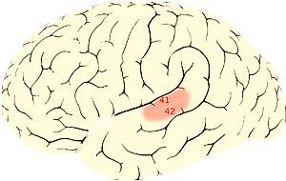

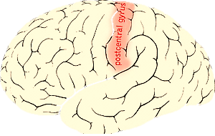

Neural Networks Brains
Brain does loads of amazing things
Hypothesis is that the brain has a single learning algorithm
Evidence for hypothesis
Auditory cortex --> takes sound signals
If you cut the wiring from the ear to the auditory cortex
Re-route optic nerve to the auditory cortex
Auditory cortex learns to see
Somatosensory cortex (touch processing)
If rewriting optic nerve to somatosensory cortex then it learns to see
With different tissue learning to see, maybe they all learn in the same way
Brain learns by itself how to learn
Auditory Cortex
Auditory cortex learns to see
Somatosensory Cortex
Somatosensory cortex learns to see

Slide 18
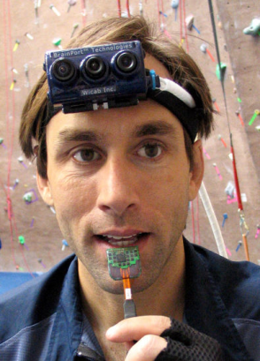
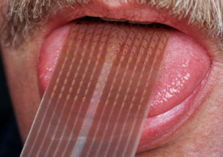


Neural Networks Brain
Sensor Representations in Brain
Seeing with your tongue
Human echolocation (sonar)
https://www.smithsonianmag.com/innovation/how-does-human-echolocation-work-180965063/

Slide 19

Neural Networks Model Representation
Neural networks were developed as a way to simulate networks of neurones
What does a neurone look like?
Three things to notice
Cell body
Number of input wires (dendrites)
Output wire (axon)
Simple level
Neurone gets one or more inputs through dendrites
Does processing
Sends output down to axon
Neurons communicate through electric spikes
Pulse of electricity via axon to another neurone

Slide 20
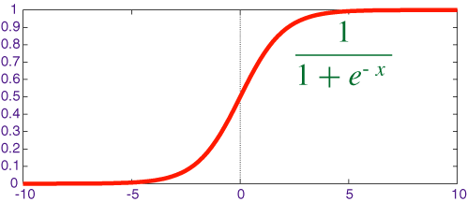
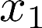
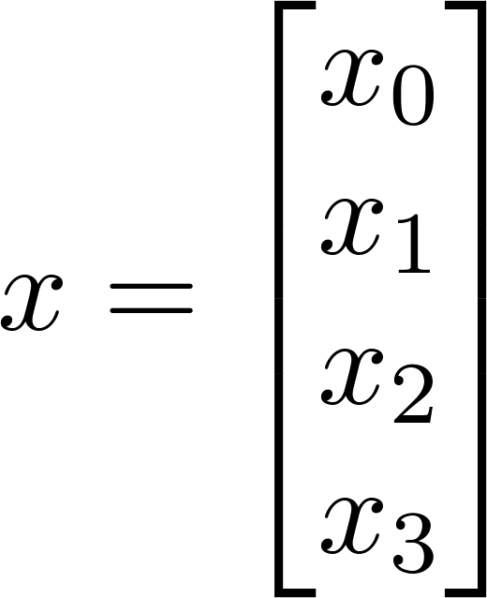
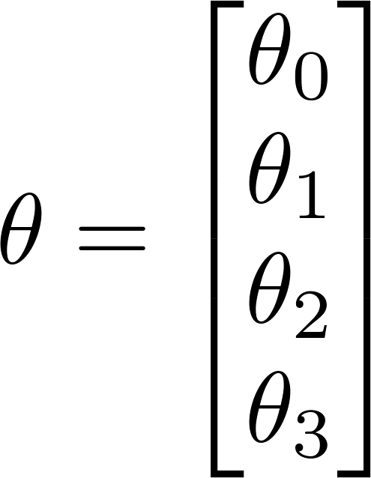
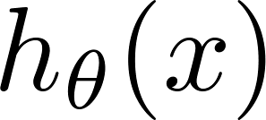
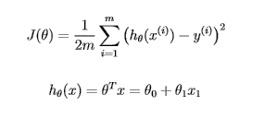
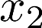
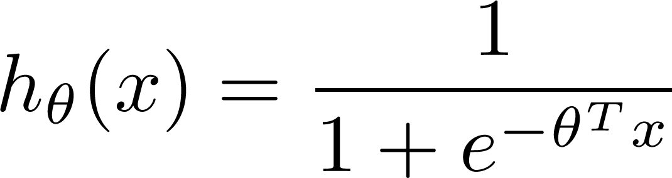
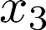
Neural Networks Neuron Model: Logistic Unit
In an artificial neural network, a neurone is a logistic unit (Perceptron)
Feed input via input wires
Logistic unit does computation
Sends output down to output wires
That logistic computation is just like our previous logistic regression hypothesis calculation
Sigmoid (logistic) activation function

Slide 21
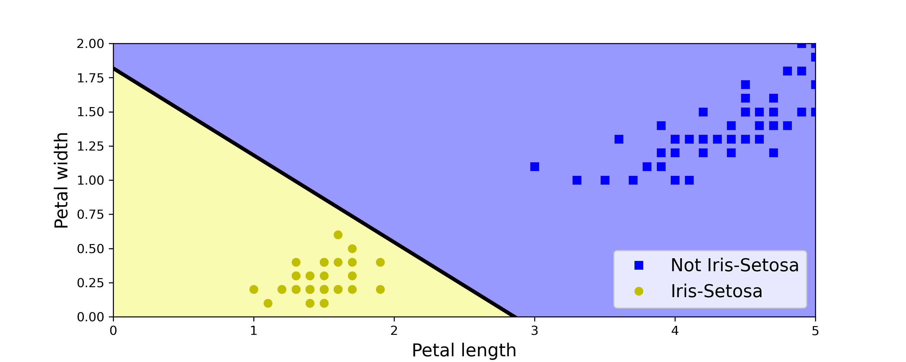
Neural Networks Neuron Model: Logistic Unit
Scikit-Learn provides a Logistic Unit class that implements a single Unit network. It can be used pretty much as you would expect—for example, on the iris dataset
Contrary to Logistic Regression classifiers, Logistic Units do not output a class probability; rather, they make predictions based on a hard threshold. This is one reason to prefer Logistic Regression over Logistic Units.
import numpy as np
from sklearn.datasets import load_iris
from sklearn.linear_model import Perceptron
iris = load_iris()
X = iris.data[:, (2, 3)] # petal length, petal width
y = (iris.target == 0).astype(int)
per_clf = Perceptron(max_iter=1000, tol=1e-3, random_state=42)
per_clf.fit(X, y)
y_pred = per_clf.predict([[2, 0.5]])

Slide 22
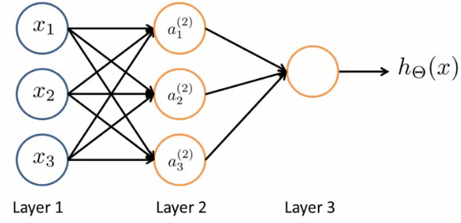
Neural Networks Neuron Model: Logistic Unit
The previous diagram represents a single neurone
Now we have a group of neurones strung together
When all the neurons in a layer are connected to every neuron in the previous layer (i.e., its input neurons), the layer is called a fully connected layer, or a dense layer.

Slide 23
Neural Networks
Here, input is x₁, x₂ and x₃
We can also call input activation on the first layer: i.e. (a₁¹, a₂¹ and a₃¹)
Three neurones in layer 2 (a₁², a₂² and a₃² )
Final fourth neurone which produces the output
Which again we can call it a₁³
First layer is the input layer
Final layer is the output layer - produces value computed by a hypothesis
Middle layer(s) are called the hidden layers
You don't observe the values processed in the hidden layer
Can have many hidden layers

Slide 24
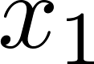
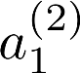
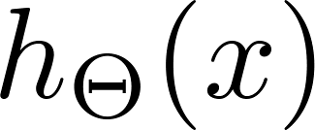
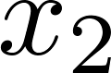
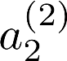
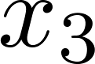
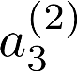
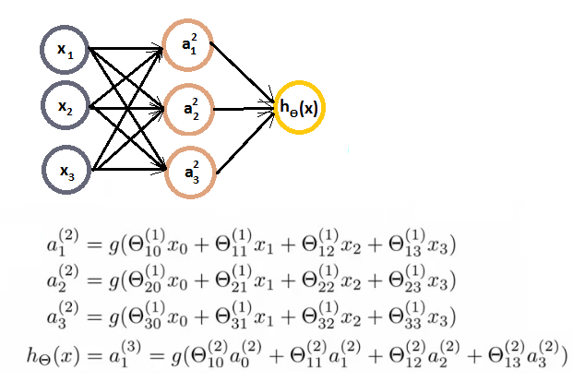
Neural Networks Computations
Here is an example with the associated calculations for the four nodes:
We have to calculate the activation for each node which depends on
The input(s) to the node
The parameter associated with that node (from the Ɵ vector associated with that layer)
Layer 1
Layer 2
Layer 3

Slide 25
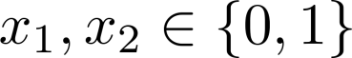
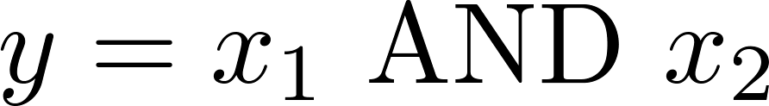
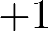




Neural Networks Simple Example 1: AND Function
One-unit neural network to compute this logical AND
Add a bias unit & some weights for the networks (i.e. Ɵ)
Ɵ₁₀¹ = -30, Ɵ₁₁¹ = 20, Ɵ₁₂¹ = 20
$$−30$$
$$+20$$
$$+20$$
$$h_{θ}\left(x\right)=g(−30+20x_{1}+20x_{2})$$

Slide 26






Neural Networks Simple Example 1: AND Function
Now with the defined weights and hypothesis, we look at the four input values
$g_{ }$ is Sigmoid function
As we can see, when we evaluate each of the four possible input, only (1,1) gives a positive output
$$h_{θ}\left(x\right)=g(−30+20x_{1}+20x_{2})$$
$${g(t)}_{ }$$
$$x_{1}$$ | $$x_{2}$$ | $$h_{θ}\left(x\right)$$
0 | 0 | $$g\left(−30\right)≈0$$
0 | 1 | $$g\left(−10\right)≈0$$
1 | 0 | $$g\left(−10\right)≈0$$
1 | 1 | $$g\left(+10\right)≈1$$
$$h_{θ}\left(x\right)≈x_{1} AND x_{2}$$

Slide 27




Neural Networks Simple Example 2: OR Function
Ɵ₁₀¹ = -10, Ɵ₁₁¹ = 20, Ɵ₁₂¹ = 20
As we can see, when we evaluate each of the four possible input and (0,1), (1,0) and (1,1) gives a positive output.
$$h_{θ}\left(x\right)=g(−10+20x_{1}+20x_{2})$$
$$x_{1}$$ | $$x_{2}$$ | $$h_{θ}\left(x\right)$$
0 | 0 | $$g\left(−10\right)≈0$$
0 | 1 | $$g\left(+10\right)≈1$$
1 | 0 | $$g\left(+10\right)≈1$$
1 | 1 | $$g\left(+30\right)≈1$$
-10
20
20
$$h_{θ}\left(x\right)≈x_{1} OR x_{2}$$

Slide 28



Neural Networks Simple Example 3: NOT Function
Negation is achieved by putting a large negative weight in front of the variable you want to negative.
Ɵ₁₀¹ = 10, Ɵ₁₁¹ = -20
As we can see, when we evaluate each of the two possible input, 1 becomes 0 and vice versa.
$$h_{θ}\left(x\right)=g(−10−20x_{1})$$
+10
$$x_{1}$$ | $$h_{θ}\left(x\right)$$
0 | $$g\left(+10\right)≈1$$
1 | $$g\left(−10\right)≈0$$
-20
$$h_{θ}\left(x\right)≈x_{1} NOT$$

Slide 29



Neural Networks Simple Example 4: XNOR Function
XNOR is short for NOT XOR
i.e. NOT an exclusive or, so either go big (1,1) or go home (0,0)
We want to structure this so the input which produce a positive output are
AND (i.e. both true) OR Neither (not only one being true)
-30
10
-10
20
-20
20
20
-20
20

Slide 30

















Neural Networks Simple Example 4: XNOR Function
Putting it all together:
$h_{θ}\left(x\right)≈x_{1} XNOR x_{2}$
-30
10
-10
20
-20
20
20
-20
20
$$+1$$
$$+1$$
$$x_{1}$$ | $$x_{2}$$ | $$a_{1}^{(2)}$$ | $$a_{2}^{(2)}$$ | $$h_{θ}\left(x\right)$$
0 | 0 | 0 | 1 | $$≈1$$
0 | 1 | 0 | 0 | $$≈0$$
1 | 0 | 0 | 0 | $$≈0$$
1 | 1 | 1 | 0 | $$≈1$$
$$−30$$
$$−10$$
$$x_{1}$$
$$20$$
$$a_{1}^{(2)}$$
$$a_{1}^{(3)}$$
$$20$$
$$20$$
$$10$$
$$20$$
$$x_{2}$$
$$−20$$
$$a_{2}^{(2)}$$
$$−20$$
Layer 1
Layer 2
Layer 3

Slide 31

Neural Networks Activation Functions
The NN algorithm works well with many activation functions, such as
The logistic function (sigmoid function):
σ(z) = 1 / (1 + exp(–z)).
The hyperbolic tangent function:
tanh(z) = 2σ(2z) – 1.
The Rectified Linear Unit function:
ReLU(z) = max(0, z).

Slide 32

Neural Networks Forward Propagation
The process of calculating the activation for all nodes to the final hypothesis is also called forward propagation
Start off with activations of input unit (i.e. the x vector as input)
Forward propagate and calculate the activation of each layer sequentially
This is a vectorised version of this implementation

Slide 33
Neural Networks Cost Function
Since we are predicting probability distributions, the cross-entropy loss is generally a good choice.
Two common loss functions that are appropriate for a classification predictive modelling problem.
Cross-entropy: Cross-entropy will calculate a score that summarizes the average difference between the actual and predicted probability distributions for all classes in the problem. The score is minimized and a perfect cross-entropy value is 0.
Sparse Cross-Entropy Loss: Sparse cross-entropy performs the same cross-entropy calculation of error, without requiring that the target variable be one hot encoded prior to training.
Integer Encoding:
Red: 1
Green: 2
Blue: 3
One hot encoded:
Red: 100
Green: 010
Blue: 001

Slide 34

Neural Networks Gradient Descent
Gradient Descent is a generic optimization algorithm capable of finding optimal solutions to a wide range of problems.
The general idea of Gradient Descent is to tweak parameters iteratively in order to minimize a cost function.
Suppose you are lost in the mountains in a dense fog, and you can only feel the slope of the ground below your feet.
A good strategy to get to the bottom of the valley quickly is to go downhill in the direction of the steepest slope.
This is exactly what Gradient Descent does:
It measures the local gradient of the error function with regard to the parameter vector θ, and it goes in the direction of descending gradient. Once the gradient is zero, you have reached a minimum!

Slide 35


Neural Networks Gradient Descent Learning Rate
You start by filling θ with random values (this is called random initialization). Then you improve it gradually, taking one baby step at a time, each step attempting to decrease the cost function (e.g., the MSE), until the algorithm converges to a minimum
An important parameter in Gradient Descent is the size of the steps, determined by the learning rate hyperparameter. If the learning rate is too small, then the algorithm will have to go through many iterations to converge, which will take a long time.
On the other hand, if the learning rate is too high, you might jump across the valley and end up on the other side

Slide 36

Neural Networks Gradient Descent
Finally, not all cost functions look like nice, regular bowls. There may be holes, ridges, plateaus, and all sorts of irregular terrains, making convergence to the minimum difficult.
If the random initialization starts the algorithm on the left, then it will converge to a local minimum, which is not as good as the global minimum. If it starts on the right, then it will take a very long time to cross the plateau. And if you stop too early, you will never reach the global minimum.
For more information about Gradient Descent, refer t the Chapter 4 of the book (Hands-On Machine Learning with Scikit-Learn, Keras, and TensorFlow)

Slide 37
Neural Networks Backpropagation
How do we minimise cost function?
We've already described forward propagation
This is the algorithm which takes your initial input into the neural network and pushes the input through that network
It leads to the generation of an output hypothesis, which may be a single real number, but can also be a vector
We're now going to describe back propagation
Back propagation basically takes the output you got from your network, compares it to the real value (y) and calculates how wrong the network was (i.e. how wrong the parameters were)
It then, using the error you've just calculated, back-calculates the error associated with each unit from the preceding layer (i.e. layer L - 1)

Slide 38
Neural Networks Backpropagation
This goes on until you reach the input layer (where obviously there is no error, as the activation is the input)
These "error" measurements for each unit can be used to calculate the partial derivatives
Gradient descent uses partial derivatives to minimise the cost function and update all the Ɵ values.
This repeats until gradient descent reports convergence

Slide 39
Neural Networks Comparing with Logistic Regression
Neural Network learns its own features
Layer 3 is a logistic regression node
The hypothesis output = g(Ɵ₁₀² a₀² + Ɵ₁₁² a₁² + Ɵ₁₂² a₂² + Ɵ₁₃² a₃²)
The only difference is, instead of input a feature vector, the features are just values calculated by the hidden layer.
The features a₁², a₂², and a₃² are calculated/learned - not original features.
Layer 1
Layer 2
Layer 3

Slide 40
Neural Networks Comparing with Logistic Regression
In NN, the mapping from layer 1 to layer 2 is determined by another set of parameters: Ɵ¹
Instead of being constrained by the original input features, a neural network can learn its own features to feed into logistic regression
Flexibility to learn whatever features it wants to feed into the final logistic regression calculation
In logistic regression, you would have to calculate your own exciting features to define the best way to classify or describe something
Here, we're letting the hidden layers do that, so we feed the hidden layers our input values, and let them learn whatever gives the best final result to feed into the final output layer

Slide 41
Neural Networks Other Network Architectures
Other architectures (topology) are possible for NNs
More/less nodes per layer
More layers
Layer 1
Layer 2
Layer 3
Layer 4

Slide 42

Neural Networks Multiclass Classification
Multiclass classification is, unsurprisingly, when you distinguish between more than two categories (i.e. more than 1 or 0)
Handwritten digital recognition problem: 10 possible categories (0-9)
Recognising pedestrian, car, motorbike or truck

Slide 43




Neural Networks Multiclass Classification
Recognising pedestrian, car, motorbike or truck
Build a neural network with four output units
Output a vector of four numbers
When image is a pedestrian get [1,0,0,0] and so on
Training set here is images of our four classifications
Want , , , etc.
when pedestrian when car when motorcycle

Slide 44

Neural Networks Multiclass Classification
While previously we'd written y as an integer {1,2,3,4} now represent y as
Training set here is images of our four classifications
Training set:

Slide 45
Neural Networks Implementing NN with Keras
Keras is a high-level Deep Learning API that allows you to easily build, train, evaluate, and execute all sorts of neural networks.
Its documentation is available at https://keras.io/.
To perform the heavy computations required by neural networks, Keras implementation relies on a computation backend.
Popular open source Deep Learning libraries:
TensorFlow, Microsoft Cognitive Toolkit (CNTK) and Theano
Other implementations that can now run Keras on are: Apache MXNet, Apple’s Core ML, JavaScript or TypeScript and PlaidML (which can run on all sorts of GPU devices, not just Nvidia).

Slide 46

Neural Networks Implementing NN with Keras
TensorFlow itself comes bundled with its own Keras implementation, tf.keras.
It only supports TensorFlow as the backend, but it has the advantage of offering some very useful extra features
The most popular Deep Learning library, after Keras and TensorFlow, is Facebook’s PyTorch library. The good news is that its API is quite similar to Keras’s, so once you know Keras, it is not difficult to switch to PyTorch.

Slide 47
Neural Networks in Python
Let’s Try Neural Networks in Python

Slide 48
Neural Networks in Python
Installing TensorFlow 2:
Use pip to install TensorFlow
python3 -m pip install --upgrade tensorflow
python -m pip install --upgrade tensorflow

Slide 49
Neural Networks in Python
Building an Image Classifier Using the Sequential API:
we will tackle Fashion MNIST.
It has 70,000 grayscale images of 28 × 28 pixels each, with 10 classes
Let's start by loading the fashion MNIST dataset. Keras has a number of functions to load popular datasets in keras.datasets. The dataset is already split for you between a training set and a test set, but it can be useful to split the training set further to have a validation set:
import tensorflow as tf
from tensorflow import keras
fashion_mnist = keras.datasets.fashion_mnist
(X_train_full, y_train_full), (X_test, y_test) = fashion_mnist.load_data()

Slide 50
Neural Networks in Python
Since we are going to train the neural network using Gradient Descent, we must scale the input features. For simplicity, we’ll scale the pixel intensities down to the 0–1 range by dividing them by 255.0 (this also converts them to floats):
You can plot an image using Matplotlib's imshow() function, with a 'binary' color map:
Here are the corresponding class names:
X_valid, X_train = X_train_full[:5000] / 255., X_train_full[5000:] / 255.
y_valid, y_train = y_train_full[:5000], y_train_full[5000:]
X_test = X_test / 255.
import matplotlib.pyplot as plt
plt.imshow(X_train[0], cmap="binary")
plt.axis('off')
plt.show()
class_names = ["T-shirt/top", "Trouser", "Pullover", "Dress", "Coat",
"Sandal", "Shirt", "Sneaker", "Bag", "Ankle boot"]
class_names[y_train[0]]

Slide 51

Neural Networks in Python
The validation set contains 5,000 images, and the test set contains 10,000 images:
Let's take a look at a sample of the images in the dataset:
print(X_valid.shape)
print(X_test.shape)
import matplotlib.pyplot as plt
n_rows = 4
n_cols = 10
plt.figure(figsize=(n_cols * 1.2, n_rows * 1.2))
for row in range(n_rows):
for col in range(n_cols):
index = n_cols * row + col
plt.subplot(n_rows, n_cols, index + 1)
plt.imshow(X_train[index], cmap="binary", interpolation="nearest")
plt.axis('off')
plt.title(class_names[y_train[index]], fontsize=12)
plt.subplots_adjust(wspace=0.2, hspace=0.5)
plt.show()

Slide 52
Neural Networks in Python
Now let’s build the neural network! Here is a classification NN with two hidden layers:
Instead of adding the layers one by one as we just did, you can pass a list of layers when creating the Sequential model:
model = keras.models.Sequential()
model.add(keras.layers.Flatten(input_shape=[28, 28]))
model.add(keras.layers.Dense(300, activation="relu"))
model.add(keras.layers.Dense(100, activation="relu"))
model.add(keras.layers.Dense(10, activation="softmax"))
model = keras.models.Sequential([
keras.layers.Flatten(input_shape=[28, 28]),
keras.layers.Dense(300, activation="relu"),
keras.layers.Dense(100, activation="relu"),
keras.layers.Dense(10, activation="softmax")
])

Slide 53
Neural Networks in Python
The model’s summary() method displays all the model’s layers, including each layer’s name, its output shape (None means the batch size can be anything), and its number of parameters.
You can easily get a model’s list of layers, to fetch a layer by its index, or you can fetch it by name:
All the parameters of a layer can be accessed using its get_weights() and set_weights() methods. For a Dense layer, this includes both the connection weights and the bias terms:
model.summary()
model.layers
hidden1 = model.layers[1]
hidden1.name
weights, biases = hidden1.get_weights()
print(weights)
print(biases)

Slide 54
Neural Networks in Python
After a model is created, you must call its compile() method to specify the loss function and the optimizer to use. Optionally, you can specify a list of extra metrics to compute during training and evaluation:
This code requires some explanation.
First, we use the "sparse_categorical_crossentropy" loss because we have sparse labels (from 0 to 9 in this case), and the classes are exclusive. If instead we had one target probability per class for each instance (such as one-hot vectors, e.g. [0., 0., 0., 1., 0., 0., 0., 0., 0., 0.] to represent class 3), then we would need to use the "categorical_crossentropy" loss instead.
If we were doing binary classification, then we would use the "sigmoid" (i.e., logistic) activation function in the output layer, and we would use the "binary_crossentropy" loss.
model.compile(loss="sparse_categorical_crossentropy",
optimizer="sgd",
metrics=["accuracy"])

Slide 55
Neural Networks in Python
Regarding the optimizer, "sgd" means that we will train the model using simple Stochastic Gradient Descent. In other words, Keras will perform the backpropagation algorithm using reverse-mode autodiff plus Gradient Descent.
For more information about optimizers, refer t the Chapter 11 of the book (Hands-On Machine Learning with Scikit-Learn, Keras, and TensorFlow)
Finally, since this is a classifier, it’s useful to measure its "accuracy“ during training and evaluation.

Slide 56
Neural Networks in Python
Now the model is ready to be trained. For this we simply need to call its fit() method:
The fit() method returns a History object containing the training parameters (history.params), the list of epochs it went through (history.epoch), and most importantly a dictionary (history.history) containing the loss and extra metrics it measured at the end of each epoch on the training set and on the validation set (if any). If you use this dictionary to create a pandas DataFrame and call its plot() method, you get the learning curves:
history = model.fit(X_train, y_train, epochs=30,
validation_data=(X_valid, y_valid))
import pandas as pd
pd.DataFrame(history.history).plot(figsize=(8, 5))
plt.grid(True)
plt.gca().set_ylim(0, 1)
plt.show()

Slide 57

Neural Networks in Python
You can see that both the training accuracy and the validation accuracy steadily increase during training, while the training loss and the validation loss decrease.
Moreover, the validation curves are close to the training curves, which means that there is not too much overfitting.
You can tell that the model has not quite converged yet, as the validation loss is still going down, so you should probably continue training.

Slide 58
Neural Networks in Python
Next, we can use the model’s predict() method to make predictions on new instances. Since we don’t have actual new instances, we will just use the first three instances of the test set:
As you can see, for each instance the model estimates one probability per class, from class 0 to class 9.
If you only care about the class with the highest estimated probability (even if that probability is quite low), then you can use the predict_classes() method instead:
X_new = X_test[:3]
y_proba = model.predict(X_new)
y_proba.round(2)
Result:
array([[0. , 0. , 0. , 0. , 0. , 0.01, 0. , 0.03, 0. , 0.95],
[0. , 0. , 0.99, 0. , 0.01, 0. , 0. , 0. , 0. , 0. ],
[0. , 1. , 0. , 0. , 0. , 0. , 0. , 0. , 0. , 0. ]],
dtype=float32)
#y_pred = model.predict_classes(X_new) # deprecated
y_pred = np.argmax(model.predict(X_new), axis=-1)
y_pred

Slide 59

Neural Networks in Python
Here, the classifier actually classified all three images correctly:
plt.figure(figsize=(7.2, 2.4))
for index, image in enumerate(X_new):
plt.subplot(1, 3, index + 1)
plt.imshow(image, cmap="binary", interpolation="nearest")
plt.axis('off')
plt.title(class_names[y_test[index]], fontsize=12)
plt.subplots_adjust(wspace=0.2, hspace=0.5)
plt.show()

Slide 60
Any Questions?

